Slide 1
Tilehurst Parish Council Parish Assembly 2015 The Neighbourhood Plan
Kevin Page,
Parish Councillor

Slide 2
5 Questions about the Tilehurst Neighbourhood Plan
What is a Neighbourhood Plan?
Why do we need one?
What is the process?
What can we learn from the pioneers?
How can we help?

Slide 3
5 Questions about the Tilehurst Neighbourhood Plan
What is a Neighbourhood Plan?
Why do we need one?
What is the process?
What can we learn from the pioneers?
How can we help?

Slide 4
What is a Neighbourhood Plan?
Locality Video Shown at this point
Notes:
Video Duration- 2 minutes
From the Locality Youtube channel

Slide 5
Part of “Localism”
Notes:
The aim is to give communities more power over development and shift attitudes to local growth

Slide 6
It’s about development and land use
Live
Eat
Park
Drink
Shop
School
Play
Work
Travel

Slide 7
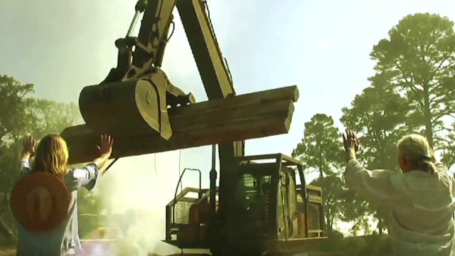
Not a way of stopping growth
Must comply with:
European Directives/legislation
National Legislation (Planning and other)
National Planning Policy
Local Plan – Core Strategy
So it can help inform, direct and shape development but not stop it

Slide 8
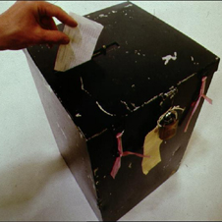
Subject to a local referendum
Completed plans are referred to a local vote
Plans with more that 50% YES vote are ‘made’
May include voters from a greater area than that of the plan and businesses where appropriate
50% of those who vote- not those who live or work in the area

Slide 9
Led by the Parish Council
Supported by a steering group
Constitution defines working practices, scope, “shelf life”, membership
Reflect inclusivity, diversity and character of area
Areas without a Parish/Town Council must create a “Neighbourhood Forum”

Slide 10
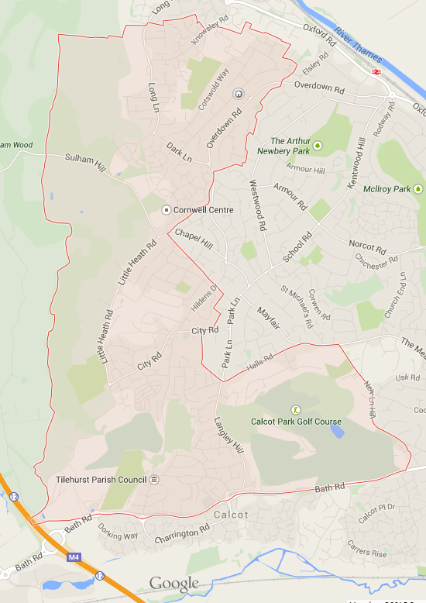
Area has to be approved by the Local Planning Authority
We chose the administrative boundary of the Parish
Waiting for approval from West Berkshire (decision expected 1st week May)

Slide 11
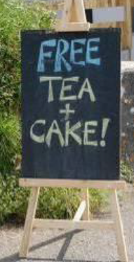
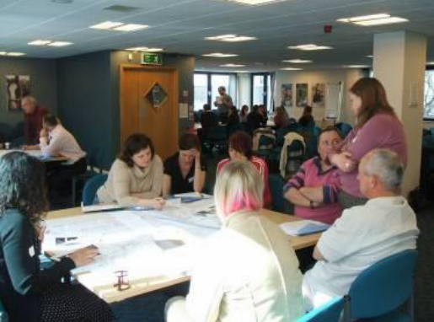
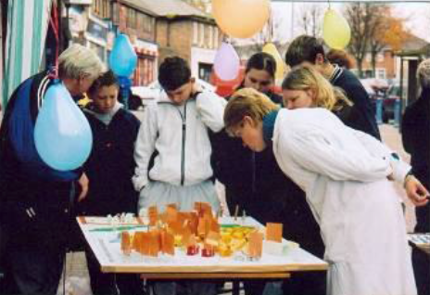
Need to engage the community

Slide 12
Must be based on “evidence”
Demographic- who lives here? Now and future
Socio-economic- who works? Where? At what?
Environmental- flooding, air quality
Designations- heritage, landscape, wildlife
Transport- services, capacity, usage
Infrastructure- capacity, fitness for purpose, need
Housing stock- type, tenure, condition, need
Land uses- potential development sites

Slide 13
They are submitted for examination
Check it meets basic conditions:
Conforms with EU and UK law
Conforms with National Planning Policy Framework
Contributes to “sustainable development”
Recommends:
Whether to put to referendum
Who to include in the vote

Slide 14
5 Questions about the Tilehurst Neighbourhood Plan
What is a Neighbourhood Plan?
Why do we need one?
What is the process?
What can we learn from the pioneers?
How can we help?

Slide 15
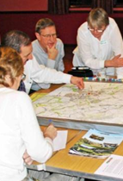
Why do we need one?
Recognizing local priorities
Influencing development
Bringing the community together
Anticipating the future
Getting the detail right

Slide 16
One more reason
Community Infrastructure Levy (CIL)
A “tax on development”
25%, uncapped, goes direct to Parish Council
15% with no plan, and capped at £100/dwelling
To be used for “the provision, improvement, replacement, operation or maintenance of infrastructure – or anything else that is concerned with addressing demands that development places on an area” (Localism Act)

Slide 17
5 Questions about the Tilehurst Neighbourhood Plan
What is a Neighbourhood Plan?
Why do we need one?
What is the process?
What can we learn from the pioneers?
How can we help?

Slide 18
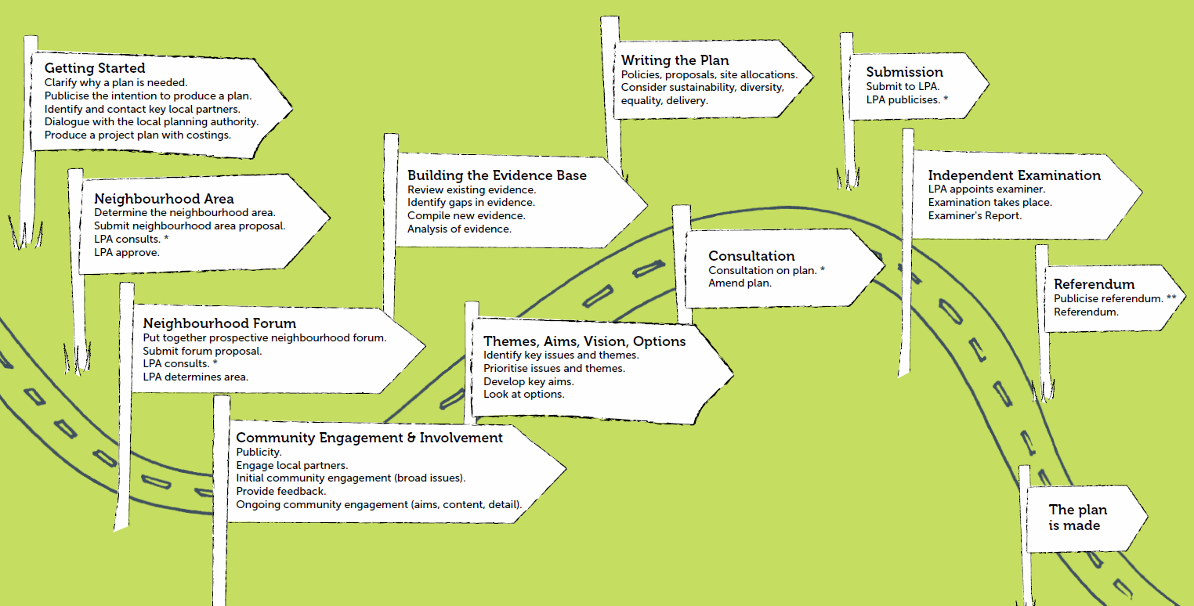
What is the process?

Slide 19
5 Questions about the Tilehurst Neighbourhood Plan
What is a Neighbourhood Plan?
Why do we need one?
What is the process?
What can we learn from the pioneers?
How can we help?

Slide 20
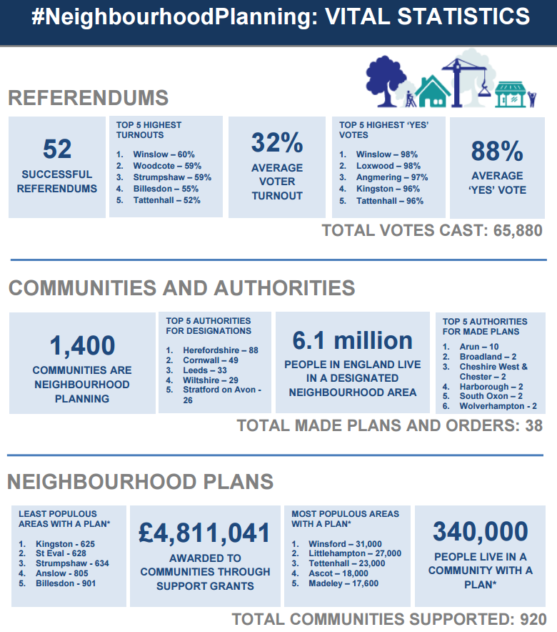
How many so far?
Figures from February 2015

Slide 21
Lessons from the pioneers
Project Management
Resources
Motivation and Pacing
Websites
Group Diversity
Input from Business
Evidence vs Opinion
Landowners and Developers
Making choices- need for audit trail

Slide 22
A vision of the future
Ascot & Sunningdale Video shown at this point
Notes:
Video duration- 4 minutes
The Plan was subject to examination by an independent examiner and was then put to all electors in the two parishes of Sunninghill & Ascot, and Sunningdale, to vote on in a public referendum that took place on 27th March 2014. It received a YES vote by an overwhelming majority of 91% of voters. On the 29th April 2014, the Plan was adopted by the Royal Borough and it now forms part of its Development Plan.
From the development group web site-
“The whole philosophy behind the local Neighbourhood Plan, and a key objective, is the involvement of the local community in planning decisions that affect us all.
Over the last 3 years, over 50 people – all volunteers and local residents – have contributed to the Plan’s development by doing research, conducting interviews with local residents and businesses, contributing to the work of the Topic Groups, assisting with the community consultations, writing the Plan itself, taking photographs, producing maps and much more.
We have had feedback from our consultations from around 1,000 households, which represents c. 10% of households in our Neighbourhood Plan area.”
Also note that in addition to the Neighbourhood Plan, the consultation resulted in defining several “projects” for the area such as-
There are 7 Projects identified in the Neighbourhood Plan:
Ascot Centre and High Street Rejuvenation
Ascot Station site redevelopment
Village Hopper Bus Service
Potential SANG sites
Protecting and improving biodiversity
Ensuring additional primary school places
Better transport management
Understanding community needs and priorities will be invaluable for the Parish Council in its aim of representing the community.

Slide 23
5 Questions about the Tilehurst Neighbourhood Plan
What is a Neighbourhood Plan?
Why do we need one?
What is the process?
What can we learn from the pioneers?
How can we help?

Slide 24
How can we help?
Everyone can play a part
We need a wide variety of skills, personalities, experience and interests
Survey Design
Statistician
Writer
Community Organiser
Photographer
PublicityManager
Communications
Social Media
Events Organiser
Website design
Liaison with West Berks Planners
Interviewer
Historian
Fundraiser
Data Analyst
Project Management
Video maker
Planning Knowledge

Slide 25
Please Join Us!
Your chance to shape the future of Tilehurst
Contact any councillor, myself or any of the steering group
Look out for the website launch as soon as we get the go-ahead

Slide 26
Any Questions?

Slide 27
Sources of images and information
Locality
Planning Advisory Service
Ascot, Sunninghill & Sunningdale NP
Department for Communities and Local Government

